Slide 1
Polymer SCFT for Studying Nafion PEM morphologies
07/22/2024
Takashi Yokokura, Wang Group

Slide 2
Outline
Overview of polyelectrolytes
What are the key interactions that need to be accounted for?
Why is the interplay between these interactions important?
Overview of our theory
What kind of insight can theory provide to polyelectrolyte systems?
Proposal for application to PEM—Pt interface
What can our theory provide on the mechanism of Pt poisoning?

Slide 3


Polyelectrolyte behavior is controlled by three main interactions
Elasticity – polymer chains are formed by a series of connected monomers
Hydrophobicity (attraction) – van der Waals interactions between monomers and solvent
Electrostatics (repulsion) – charged monomeric groups and dissolved salt ions
Monomer
Solvent
$$+$$
$$−$$
The relative strengths of these interactions are determined by monomer chemistry (e.g., backbone, sidechain EW, etc.) and environment (e.g., temperature, humidity)

Slide 4
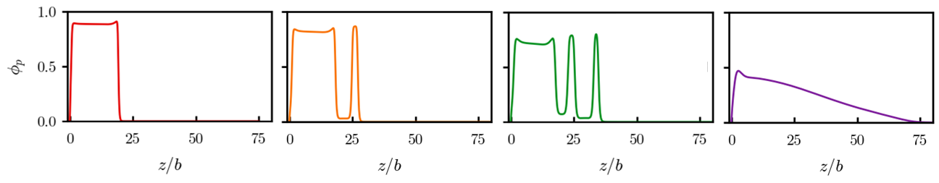
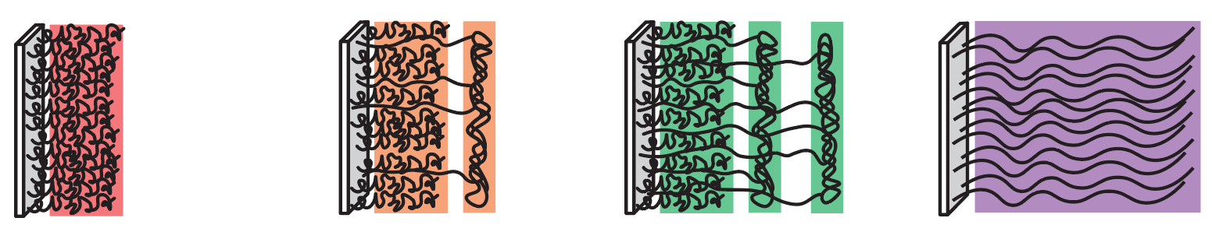
These interactions dictate polyelectrolyte morphology
Competition between hydrophobicity, long-range electrostatics, and polymer elasticity can lead to complex morphologies
Example: moderately charged brushes for decreasing hydrophobicities $χ$
Polymer density distributions from SCFT
Corresponding schematic (insight)
Fully condensed
(Attraction-dominated)
Microphase segregated
Fully swollen (Repulsion-dominated)

Slide 5
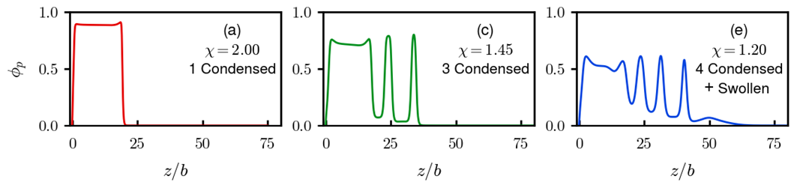
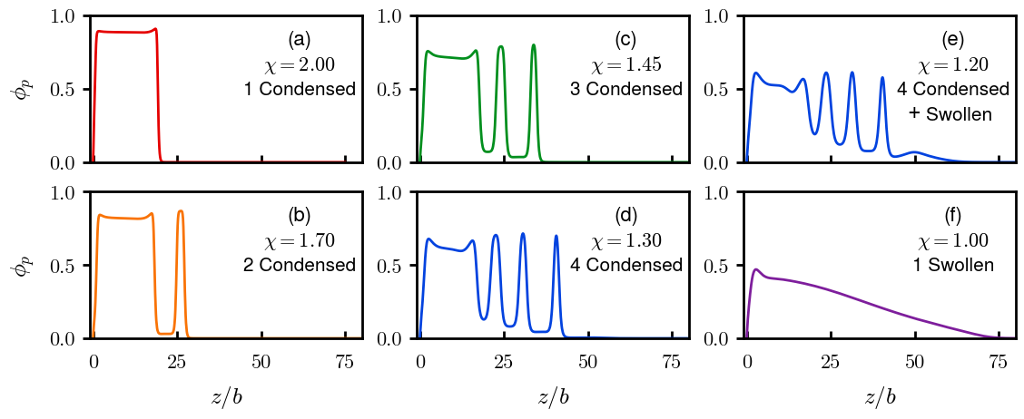

Slide 6
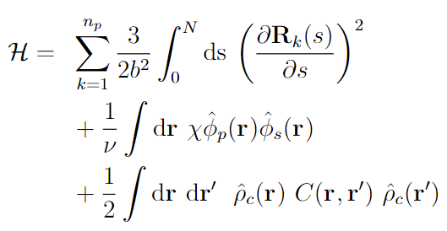





Our SCFT systematically includes these coupled interactions
Elasticity (Gaussian chain)
Hydrophobicity (Flory—Huggins)
Long-range electrostatics
Polymer path
Local polymer volume fraction
Local solvent volume fraction
Local charge density
Coulomb operator (PB equation)

Slide 7
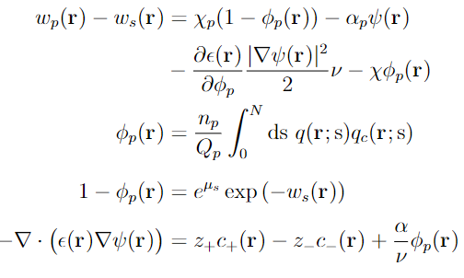

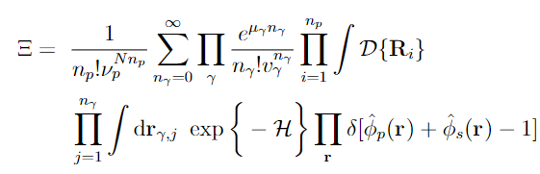

Our SCFT systematically includes these coupled interactions
Self-consistent Field Equations
Interactions
System
Particle-to-field and Hubbard—Stratonovich transformations, saddle-point approximation, functional minimization
For PEMs, we are most interested in polymer, sidechain, and proton distributions

Slide 8
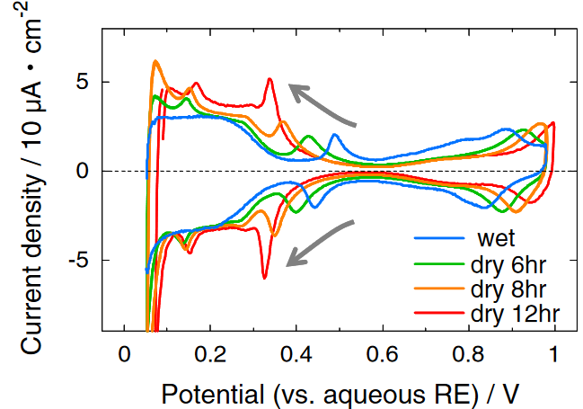
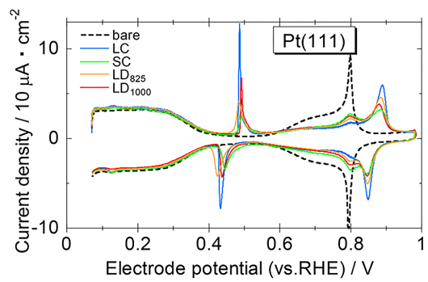
Motivation
For hydrogen fuel cells, Pt loading/efficiency is limiting factor for cost/efficacy
Leading theory: Pt poisoned by adsorbed ionomer SO3 at high operating V
However, scientific community has limited understanding of polymer physics
Using polyelectrolyte brush SCFT can provide physical insights as well as computational framework for rational design of PEM ionomers
SO3 (ad/de)sorption
Relevant experiments:
SO3 adsorption measured by cyclic voltammetry (CV) – 0.100 M HClO4
Apply potential at some scanning rate, measured current corresponds to interaction at electrode (e.g., reaction, adsorption)
(top) As humidity decreases, more current at lower voltage
Thus, as ionomer—Pt distance decreases, more SO3 adsorption
(bottom) Long ionomer sidechains (LC) more current than short sidechain (SC)
Note: LD = long distance between ether/SO3H; discussion becomes muddled on effect
Kodama et al. (2013) Electrochem. Commun. Kodama et al. (2018) ACS Catal.

Slide 9
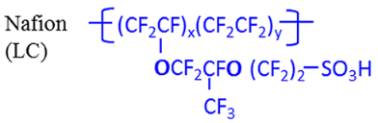
System
Schematic/Simplified system:
Polymer brush immersed in solution
Solution in contact with positively charged electrode
In real fuel cell:
Proton source from splitting of hydrogen (cathode, far left of schematic)
Proton sink from reaction with oxygen at Pt, forming water (anode, right side of schematic)
In CV experiments:
Pt coated with thin film of ionomer immersed in solution of 0.100 M HClO4
Preliminary SCFT model:
Grafted polymers are Nafion sidechains “grafted” onto the bulk ionomer membrane
In the future, model can be extended to consider entire Nafion chains to more accurately describe poisoning mechanism
+
+
−
+++++++++++
+
+
+
−
+
+
+
−
+
+
+
+
−
+
+
+
−
+
+
+
−
+
+
Backbone
Sidechain

Slide 10
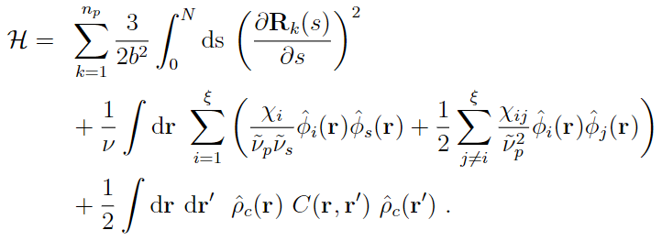
Model
Interactions
Self-consistent field theory for charged multiblock macromolecules
Coupled system of 5 algebraic equations and 2 partial differential equations
For sidechain-only system, 2 blocks; Block 2 contains -1e for SO3-
F-H parameters taken from literature (Wu, Paddison, Elliot, Energy Env. Sci. 2008. 1. 284-293)
Elastic energy
Flory-Huggins (Hydrophobicity)
Electrostatics

Slide 11
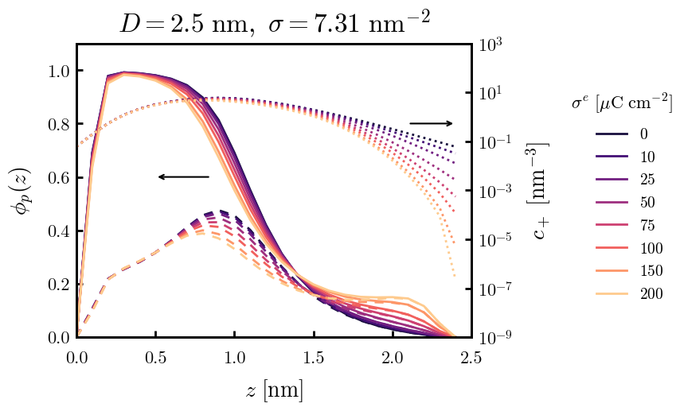
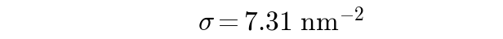
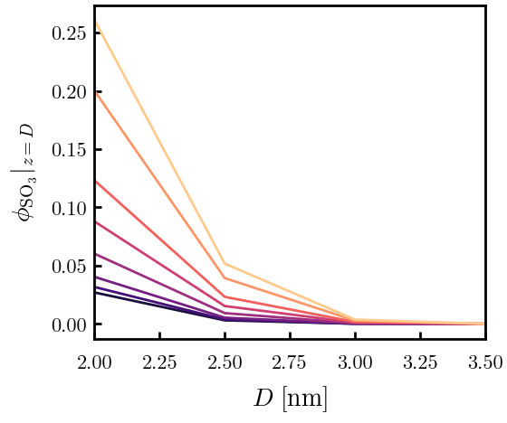

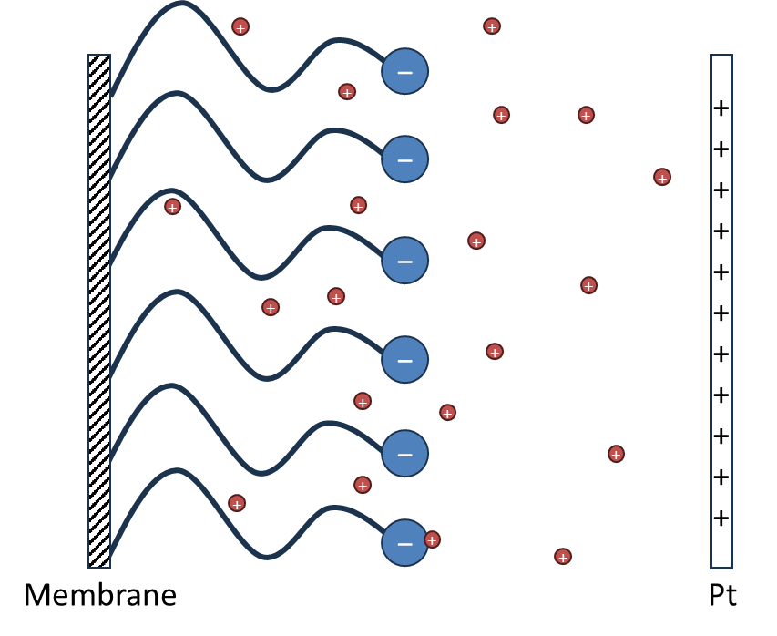
Sidechain only (Continuous Gaussian Chain)
Model: “grafting surface” is bulk membrane/thin film; only considering elasticity of sidechains
True grafting density unknown, 7.31 c/nm² is approximately the density of sidechains based on the random walk of its backbone
(Left) Density of polymer on Pt surface as a function of membrane–Pt separation distance. Colors indicate Pt surface charge density
(Right) Polymer density distributions (solid) and proton distributions (dotted) for D = 2.49 nm. Density distribution of SO3 bead is dashed.
Ionic strength 0.100 M

Slide 12
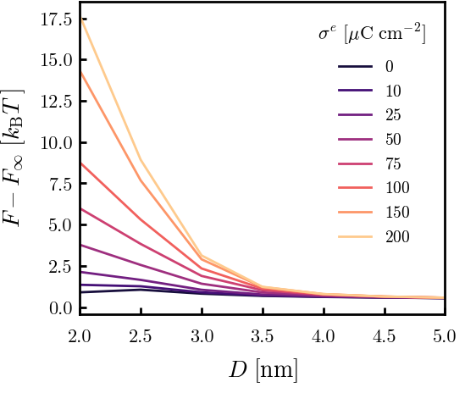
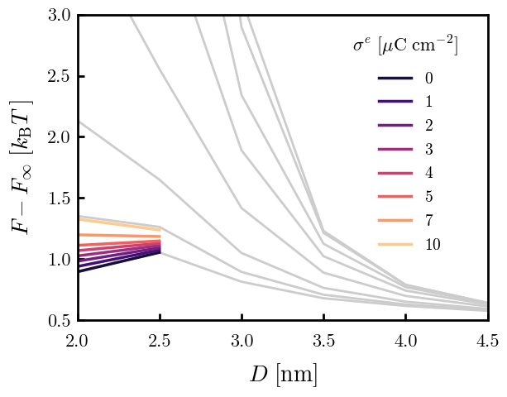
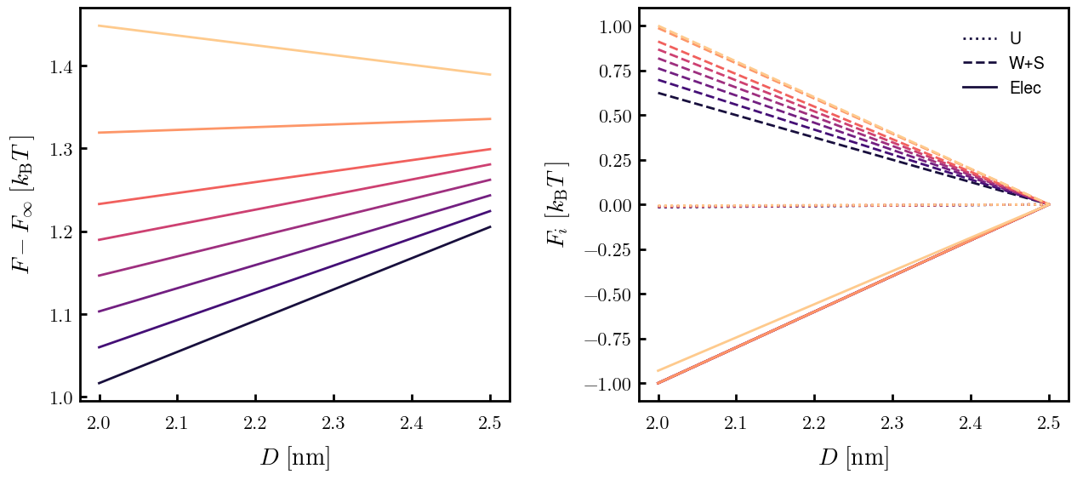
Sidechain only (Continuous Gaussian Chain)
0.100 M
In CV data, reaction goes to completion by 0.5 V (vs. RHE)
Surface charge (metal) ~10 uC/cm² according to Saha & Zenyuk. JPCC. 2021.
(Top) SCFT free energies as a function of D.
(Top right) Free energies for 1—10 uC/cm² colored. Small D is favorable at low charges, becomes unfavorable as surface charge reaches ~7 uC/cm²
(Bottom right) Normalized contributions to free energy for 1—10 uC/cm². Contributions that equal 1 at D = 2.0 are the dominant interactions.
U: Hydrophobicity; W+S: Elastic/Polymer; Electrostatic
For < 10 uC/cm², electrostatic interactions outweigh elastic penalties and lower D is favorable. At 10 uC/cm², elastic penalties become dominant and higher D is favorable.
Takeaway: competition between elastic stretching of sidearms and electrostatic attraction balances at 7 uC/cm² (very roughly 0.5 V)

